Slide 1
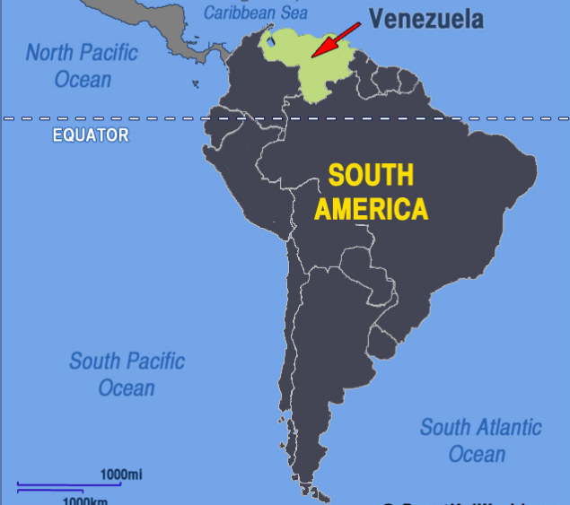
VENEZUELA CRISIS
Location : north coast of south America
Capital : Caracas
President : Nicolas Maduro
Population : 32,814,349 (2018)
Till now around 4 million Venezuelans left country due to Hyperinflation

Slide 2
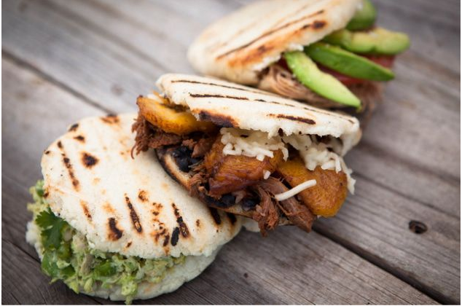
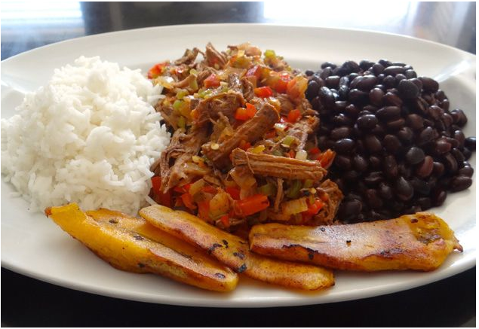
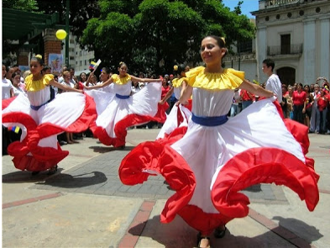
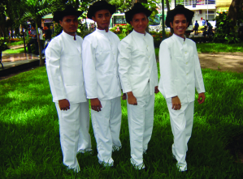
Cuisine:- Venezuelan cuisine is influenced by its European, West African, and Native American traditions.
Padello criollo
Arepas
culture
clothing
liqui liqui

Slide 3
Religion and Meeting Etiquette Venezuela
Freedom of religion is guaranteed by the Venezuelan constitution.
More than 90% of the population is Roman Catholic
Always introduce yourself to the eldest person first in group.
Business cards are given before meting.

Slide 4
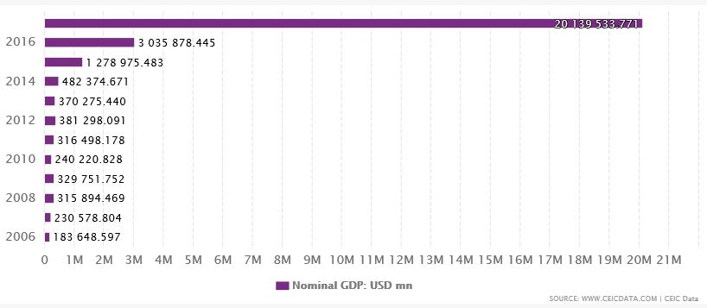
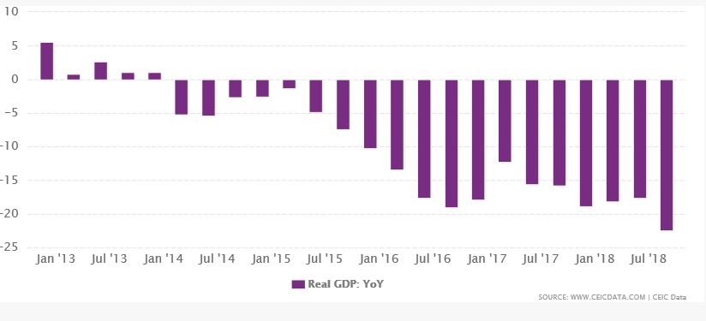
Impact on GDP

Slide 5
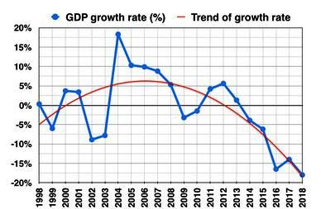
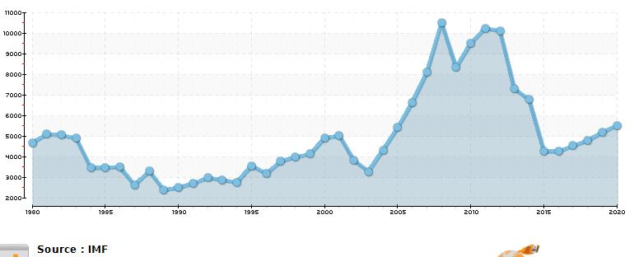

Slide 6
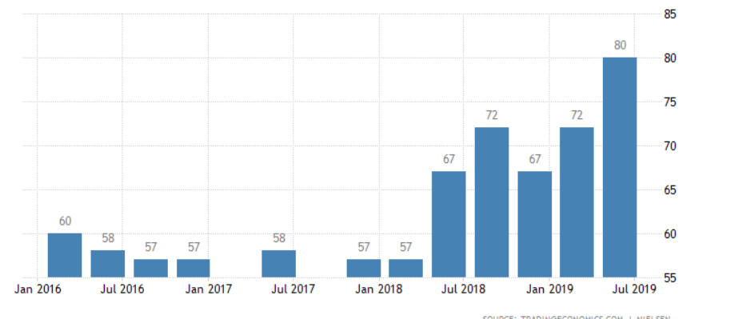
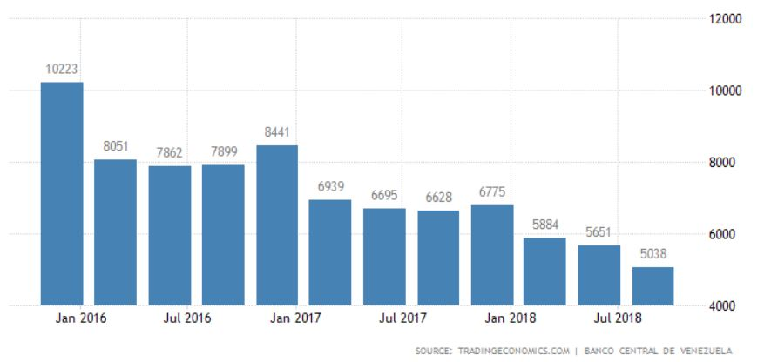
Consumer confidence
Consumer Spending

Slide 7
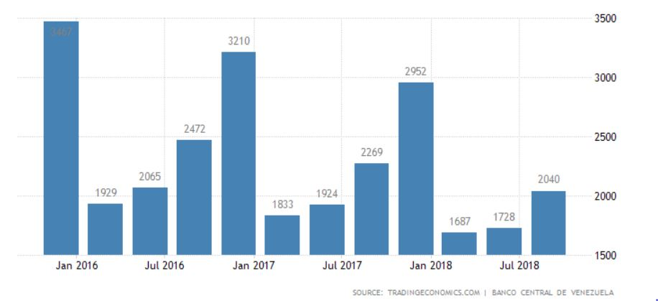
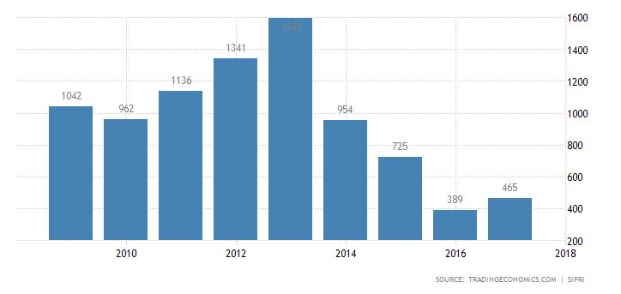
Venezuela Government spending
Venezuela Military Expenditure

Slide 8
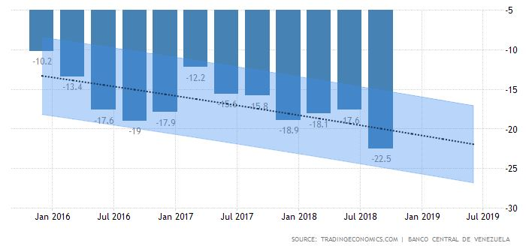
VENEZUELA GDP
GDP in Venezuela is expected to be 280.00 USD Billion in last quarter of 2019
Venezuela GDP is projected to trend around 300.00 USD Billion in 2020

Slide 9
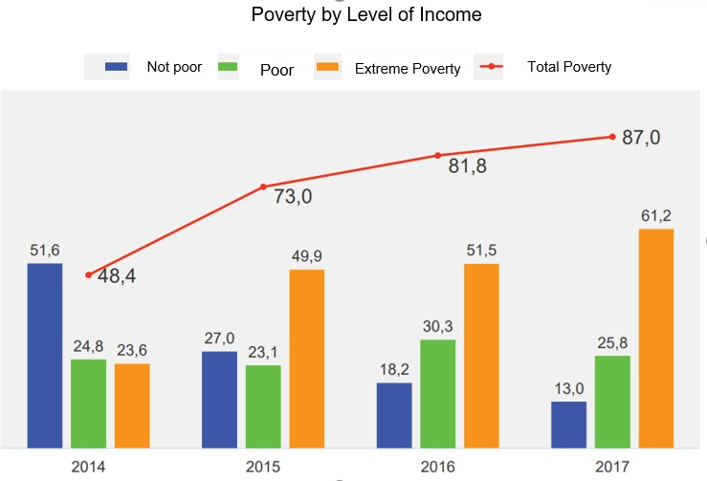
Impact on Labour
Industry shutdowns
Exodus
Poverty and workers
Health impact

Slide 10
Currency
Before1879:- Venezolano 5bolivar =1venezolano
Bolivar was defined on silver standard=4.5g fine silver
1887 gold become as standard and in 1930 gold went off
1934 U.S.Doller as Exchange Rate 1USD=3.914
7th march 2007:- Bolivar Furete
2.15VBF=2.60VB for food healthcare goods & 4.30VB for cars chemicals
electronics
Ratio 1000VB=1VBF
20th August 2018:- Bolivar soberano
Ratio 100000VB=1VBS

Slide 11
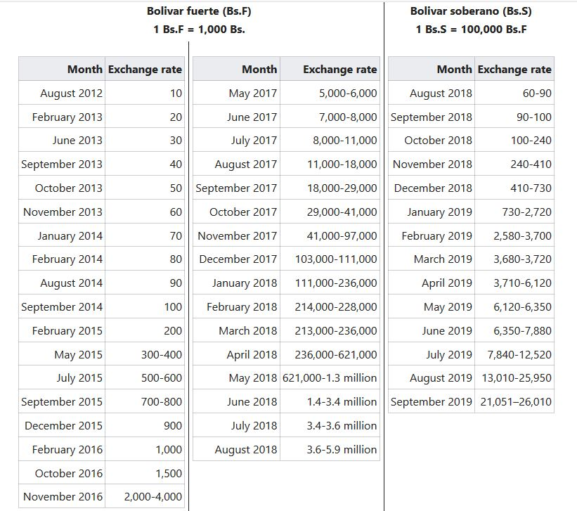
Foreign exchange rate of the Venezuelan bolivar to one US Dollar between 2012 to 2019.

Slide 12
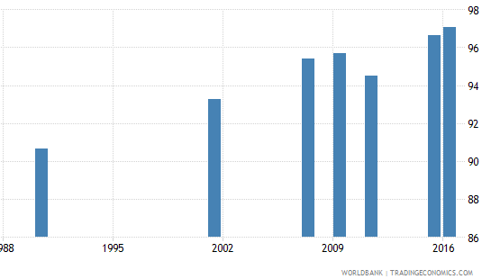
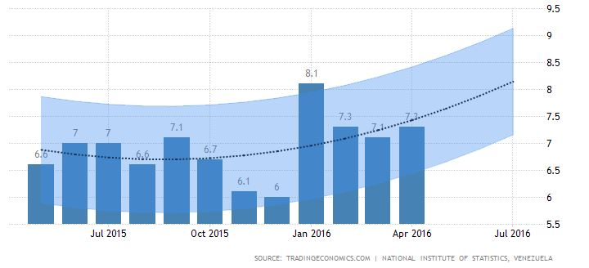
UNEMPLOYMENT
Literacy Rate
Unemployment Rate

Slide 13
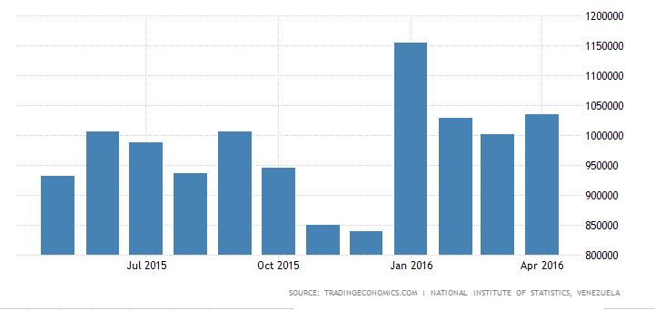
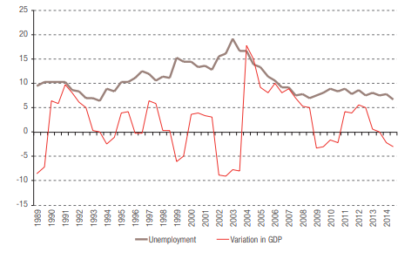
Unemployed Persons
Growth Effecting Unemployment

Slide 14
VENEZUELA INFLATION
NORMAL INFLATION:- Inflation is the nominal rise in prices of goods and services.
HYPER INFLATION:-
It is a rapid increase in prices of goods and services more than 50% in a month.
CAUSES:-
Printing Excess Money
Loss of currency value:
Falling of PDVSA
Falling of oil production
Decreasing in the foreign reserves
Debt problem

Slide 15
INFLATION RATES
YEAR | RATE
2013 | 52.8
2014 | 69%
2015 | 181%
2016 | 800%
2017 | 2,616%
2018 | 1M
2019 | 10M(IMF Estimated Value)
This table indicates the inflation rates from 2013-2019, where in 2019 IMF is estimating about 10M, the ongoing hyperinflation crisis is more severe than those of Argentina, Bolivia, Brazil, Nicaragua, and Peru in the 1980s and 1990s, or that of Zimbabwe during the mid-2000s.

Slide 16
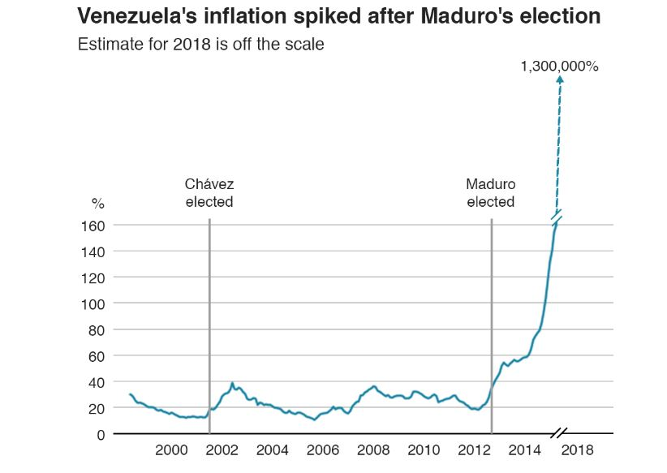
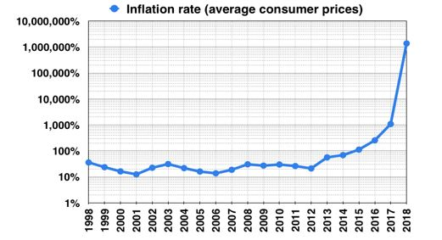
INFLATION:-

Slide 17
PRICE CONTROLS AND SHORTAGES
When oil prices came down there is a lack of food and other basic needs where the country is totally dependent on imports for their consumption
But foreign currency controls have stop ability to pay for imports and US dollars are short in supply.
So Government imposed Price controls but it is difficult to earn a profit
In 2016 goods were 17 times costlier on the black market including staples cost 100 times compared to official price.

Slide 18
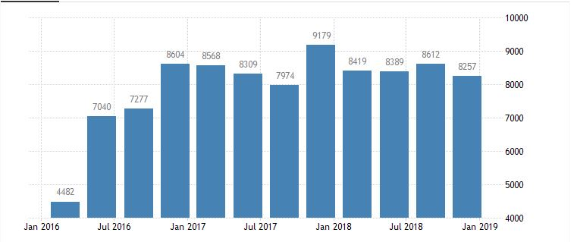
IMPACT ON TRADE
The top exports of Venezuela are Crude Petroleum($22.2B), Refined Petroleum ($2.86B), Acyclic Alcohols($456M), Iron Reductions ($305M) , Iron Ore($280M), Animal Products,etc
The top export destinations of Venezuela are the United States ($11.6B), China ($6.42B), India ($5.25B), Singapore ($1.25B) and Spain ($390M).
From 1992 to 2018 Venezuela average exports are 11150.43 USD Million and in 2008 it reached upto 31468 which is all time highest value .

Slide 19
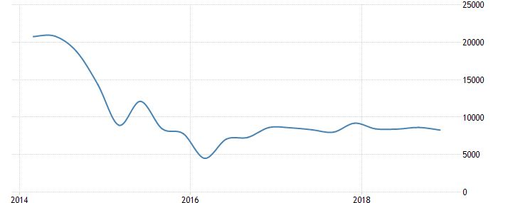
2014-2018 EXPORTS:-
Unit- USD Million
2018 third quarter- 8612.00
2018 fourth quarter- 8257.00
Highest- 31648.00
Lowest- 2995.00

Slide 20
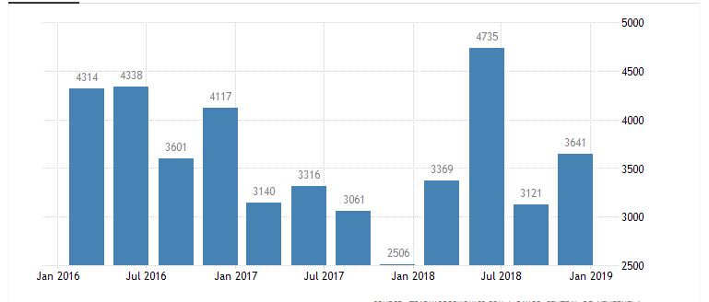
IMPORTS
The most recent imports are led by Refined Petroleum which represent 21.7% of the total imports of Venezuela, followed by Corn, electronics, chemicals, agricultural products and livestock and base metals.
The top import origins of Venezuela are the United States ($3.45B), China ($1.65B), Mexico ($1.08B), Brazil ($469M) and Colombia ($318M).
From 1992 to 2018 Venezuela average imports are 6636.58 USD Million and fourth quarter of 2012 it went up to 19338 USD Million which is all time highest value.

Slide 21
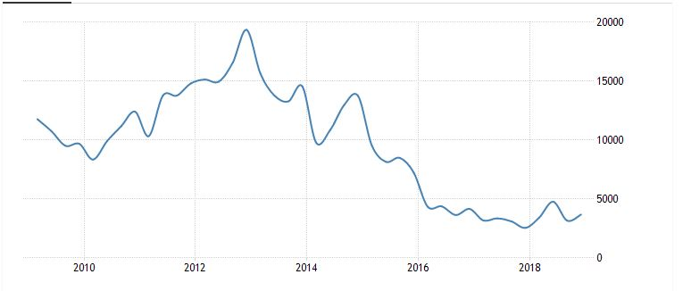
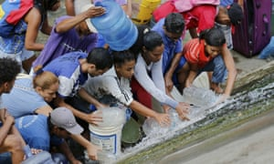
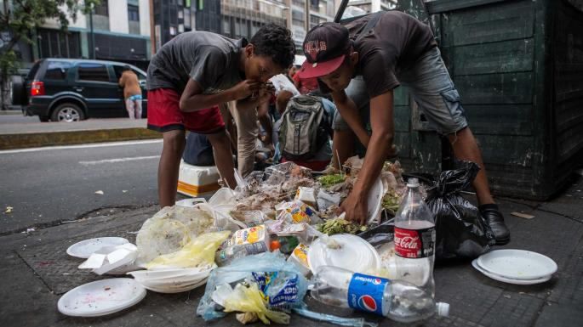
2010-2018 IMPORTS:
Unit- USD Million
2018 third quarter- 3121.00
2018 fourth quarter- 3641.00
Highest- 19338.00 in 2012
Lowest- 1970.00 in 1970

Slide 22
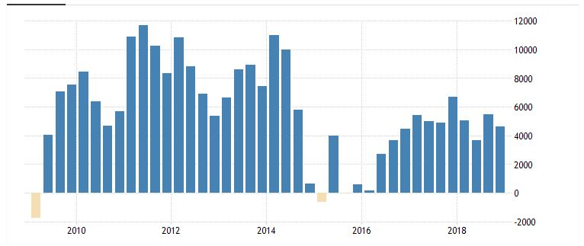
TRADE BALANCE:-
Balance of Trade in Venezuela averaged 4335.85 USD Million from 1990 until 2018, reaching an all time high of 18496 USD Million in the third quarter of 2008 and a record low of -3154 USD Million in the fourth quarter of 2008 which is due to shipments of oil (96 percent of total exports)

Slide 23
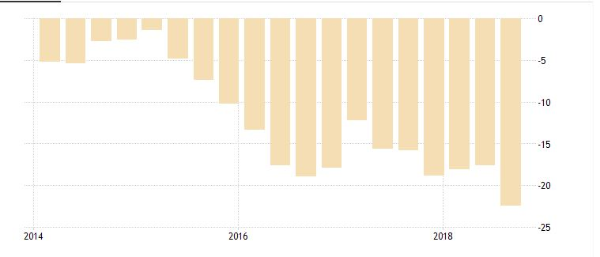
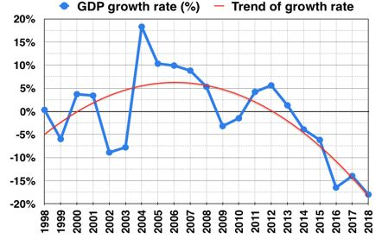
IMPACT ON GROWTH RATE:-
In 2007 oil price went up Venezuela economy grew by 9%.
Oil prices fell down resulting in major loss to the economy
Unit- percent
2018 third quarter:- -17
2018 fourth quarter:- -22
Highest:- 36.1 in 2004
Lowest:- -26.7 in 2003

Slide 24
SANCTIONS ON VENEZUELA
Venezuela crisis and protests.
Impact of Sanctions.
How its is overcoming sanctions.

Slide 25
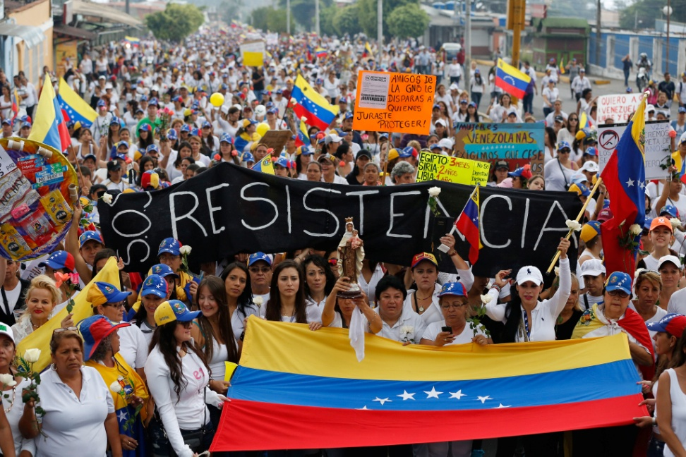
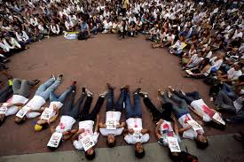
VENEZUELA PROTESTS AND CRISIS:
2014 Venezuelan protests
2017 Venezuelan protests

Slide 26
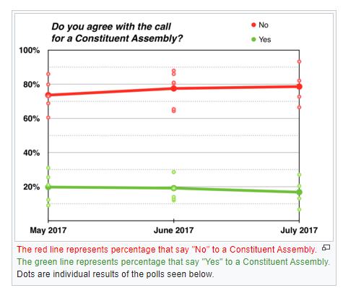
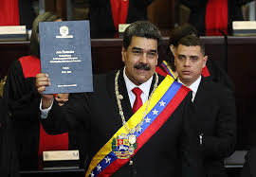
VENEZUELA PROTESTS AND CRISIS:
Venezuelan Constituent Assembly election
2018 Venezuelan presidential election

Slide 27
IMPACT OF SANCTIONS:
The International Monetary Fund suspended the Venezuelan leader’s access to almost $400 million of special drawing rights.
The US and UK sanctions restricted, retrieving the gold in the Bank of England which is 1.2 billion dollars.
Sanctions on shipping companies ,which put a chokehold on the country’s trading, is stopping shipping in its tracks.
Sanctions on Central Bank and other banks in Venezuela by USA.These sanctions prohibited the Venezuelan government from borrowing in US financial markets.

Slide 28
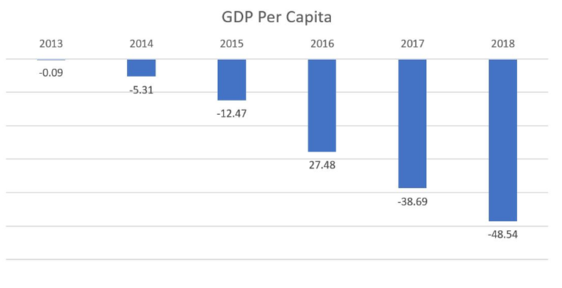
IMPACT OF SANCTIONS:
sanctions prevent the economy from recovering from deep recession as the GDP has already declined and consumer price inflation is increasing.

Slide 29
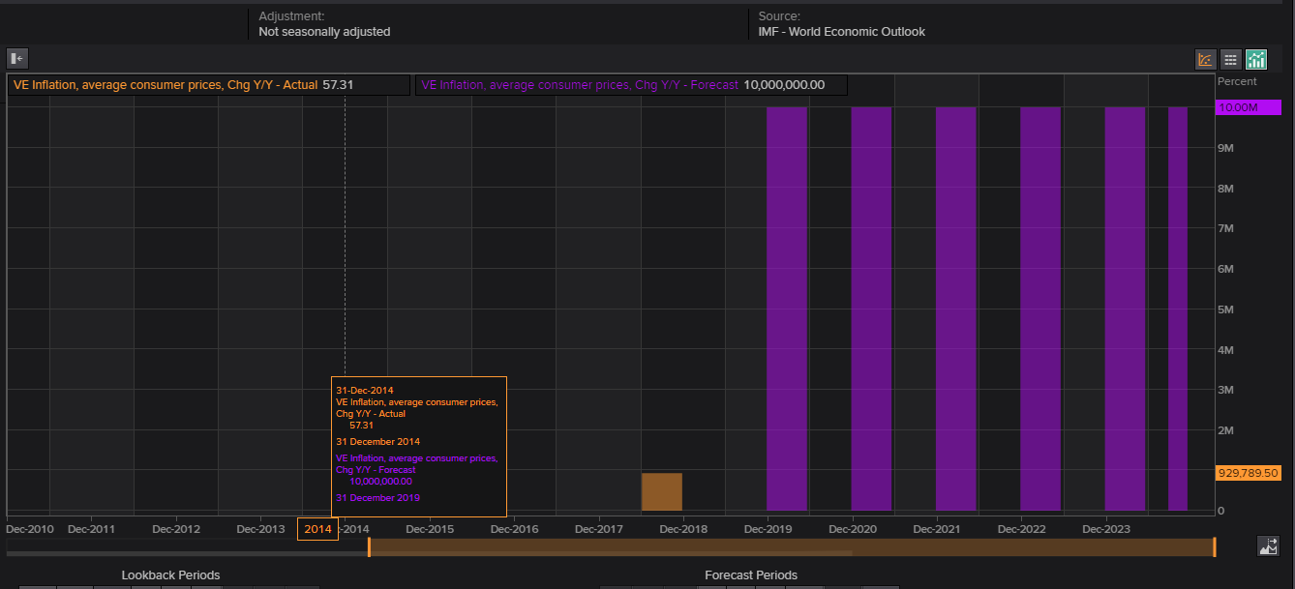
IMPACT OF SANCTIONS:
CONSUMER PRICE INDEX:

Slide 30
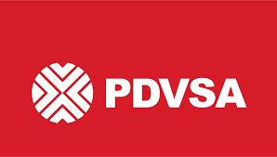
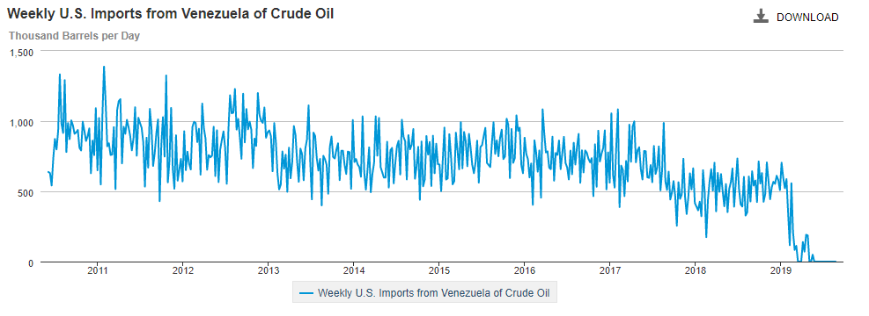
IMPACT OF SANCTIONS
The imposed sanctions on the (PDVSA) Venezuelan state-owned oil and Natural Gas Company prevent PDVSA from being paid for petroleum exports to the US($7 Billion).
US Exporting naphtha, light oil to Venezuela.

Slide 31
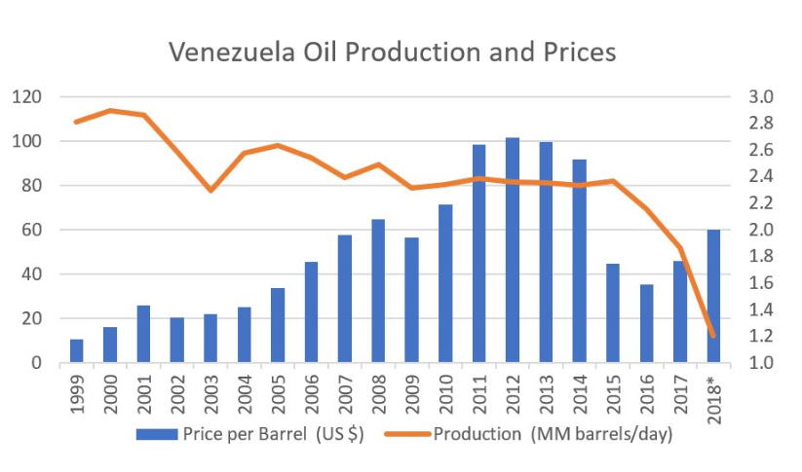
IMPACT OF SANCTIONS
The collapse of oil barrel price in 2014 and political instability, corruptions in the government and dependency on oil made the country to fall into economic cries, further the sanctions on this made the country even worst. This leads the imports to reduce.

Slide 32
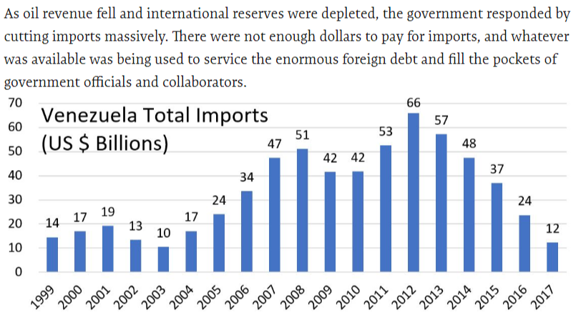
IMPACT OF SANCTIONS

Slide 33
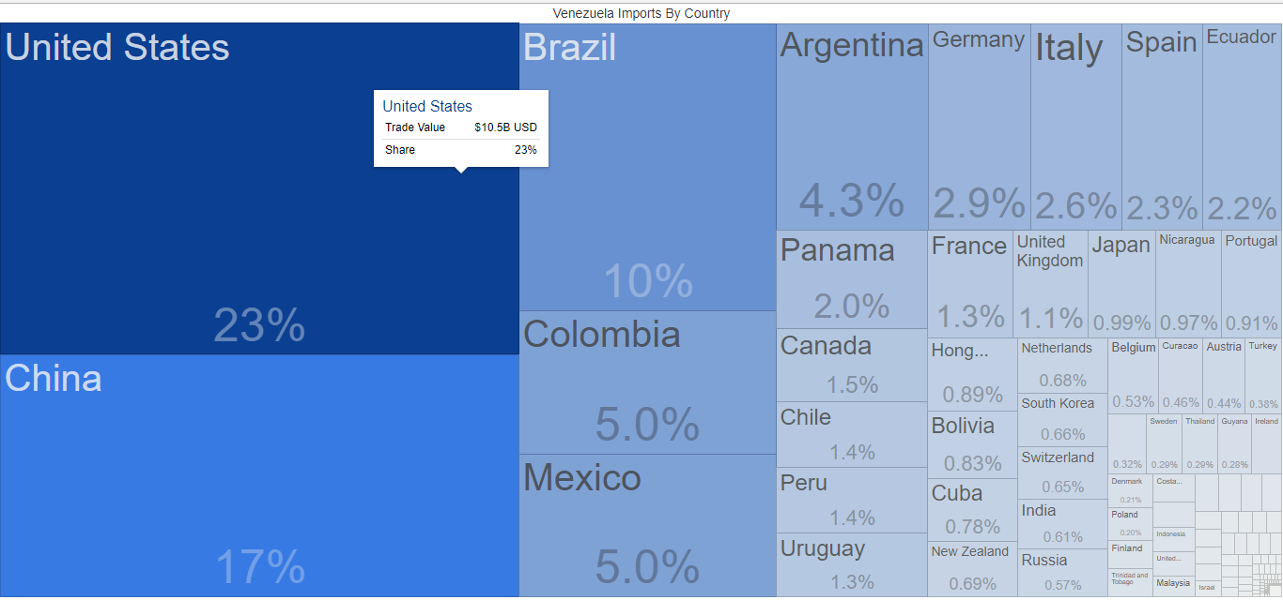
IMPACT OF SANCTIONS
Venezuela imports about 23% and exports about 24%to US due to these sanctions the imports and exports of it decreased drastically.
VENEZUELA IMPORTS

Slide 34
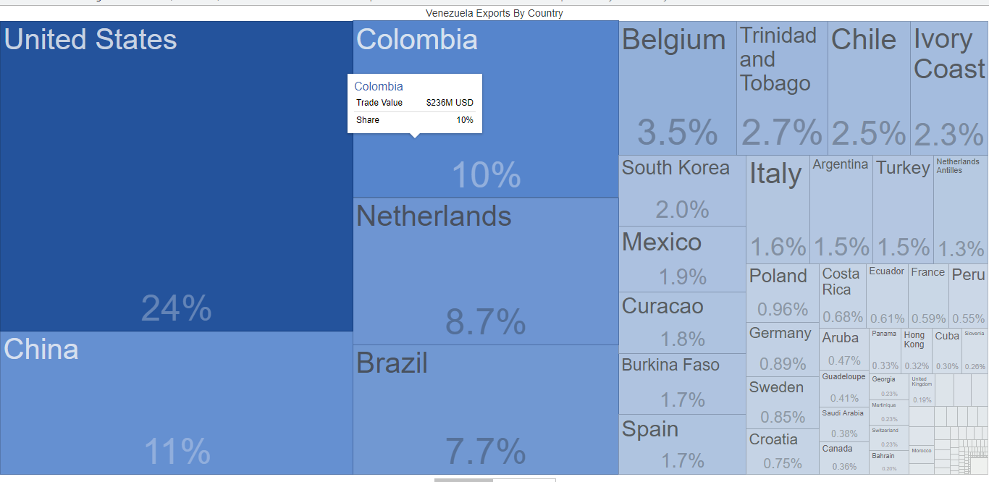
IMPACT OF SANCTIONS
EXPORTS OF VENEZUELA

Slide 35
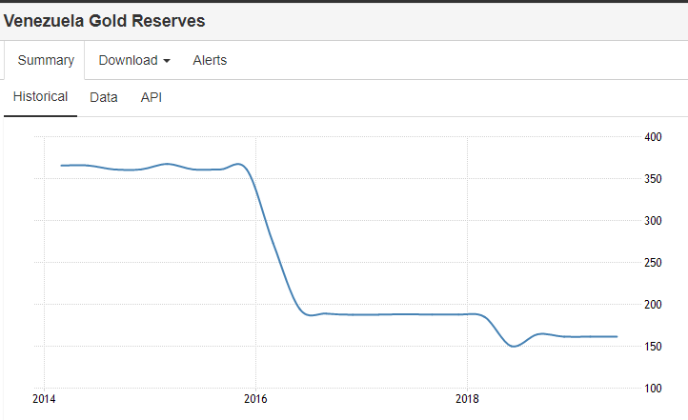
IMPACT OF SANCTIONS
Venezuela's third-largest export (after crude oil and refined petroleum products) is gold. The World Gold Council reported that Venezuela's foreign-held gold reserves had fallen by 69% during Maduro’s presidency .

Slide 36
IMPACT OF SANCTIONS
Through Petrocaribe, Caribbean countries including Haiti and Jamaica had been able to finance 40% of their Venezuelan crude oil purchases over 25 years at 1% interest.
The US sanction had severe impact the human life and health.

Slide 37
HOW VENEZUELA IS OVERCOMMING THESE SANCTIONS
Venezuela is strengthening its alliance .
Strengthen bond with Russia regarding purchase of medication.
Maduro ordered PDVSA to move its European office to Moscow to protect PDVSA's overseas assets from US sanctions.
China and Russia increased its oil imports of Venezuela. 233,000bpd in February 2019, immediately after the US sanctions cut off Venezuela oil from US market, those exports to china nearly tripled to 650,000bpd.
New Chinese Oil Investment(increasing production by 120,000 barrels per day).

Slide 38
HOW VENEZUELA GOVERNMENT CAN STOP HYPERINFLATION
Adapting other countries currency.
Introducing virtual currency.

Slide 39
MEASURES:
1. Full Dollarization Like Zimbabwe.
DRAWBACKS:
Ability to conduct monetary policy.
2. Virtual Currency like Brazil.
It will have three phases.
Fiscal debts and deficits.
Creation of virtual currency.
Extinguished the present currency.

Slide 40
AUSTERITY MEASURES:-
It is an official action taken by a government to reduce the amount of money it spends, or the amount of money that people in a country spend. These harsh steps are taken to lower budget deficits and avoid a debt crisis.
1. Increase in taxes
2. Decrease in government spending
3. Change in Government Programs

